Slide 1

Control of Biochemical Systems
Herbert Sauro et al
Bioengineering, University of Washington

Slide 2
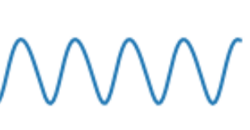
Signal Transmission and Homeostasis
A.
B.
S
Maintaining an output constant in the face of varying demand
Faithfully transmitting a signal from process A to process B without loss of signal

Slide 3
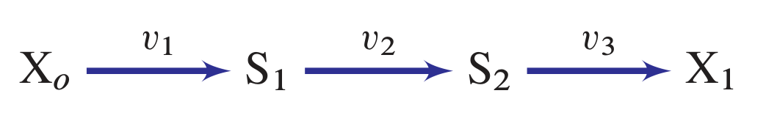
Maintaining an output constant in the face of varying demand
Examples:
1. ATP production by Glycolysis
2. Amino Acid Biosynthesis
3. ERK signal in EGF pathway
Output
Production Unit
Varying Demand

Slide 4
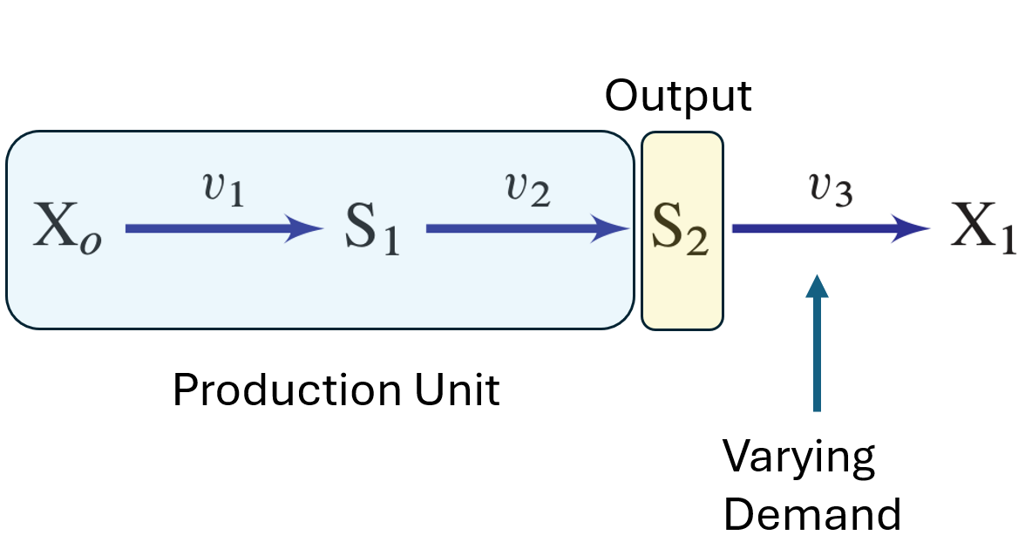
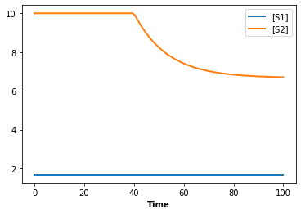
Maintaining an output constant in the face of varying demand
Const Xo
Xo -> S1; k1*Xo
S1 -> S2; k2*S1
S2 ->; demand*S2
at time > 40: demand = 1.5*demand
k1 = 0.1; k2 = 0.3
demand = 0.05
Xo = 5; S2 = 10; S1 = 1.6666666
Increase demand

Slide 5
How do we measure how sensitive the steady state level of S2 is to changes in demand?
Increase demand

Slide 6
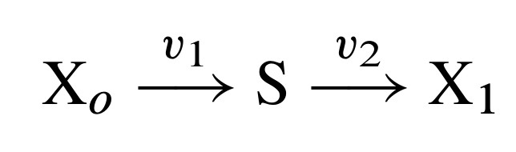
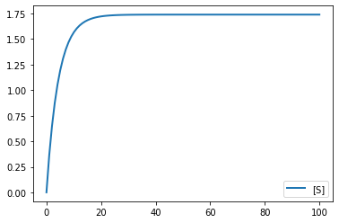
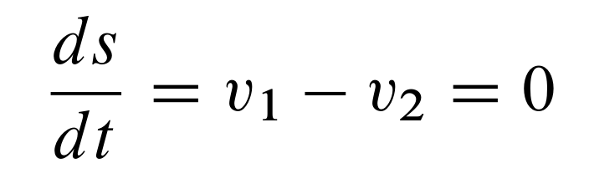
Small Example
Two step pathway, Xo and X1 are fixed in order to have a state.
At steady state:

Slide 7
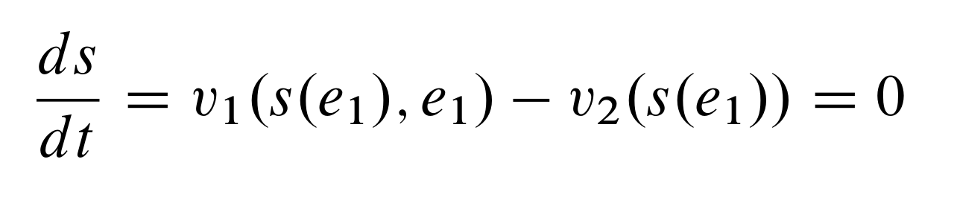
Small Example
e1
e2
At steady state as a function of e1:

Slide 8
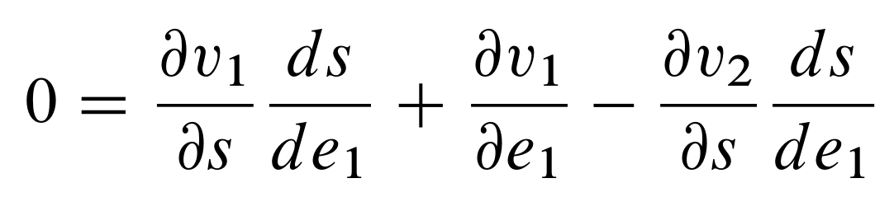
Small Example
e1
e2
Differentiate with respect to e1:

Slide 9
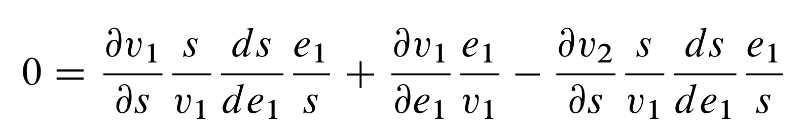
Small Example
e1
e2
Scale each derivative to eliminate units:

Slide 10
Small Example
e1
e2
Local sensitivities (elasticities)
Global sensitivities (control coefficients)

Slide 11
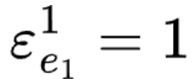
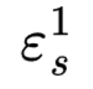
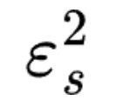
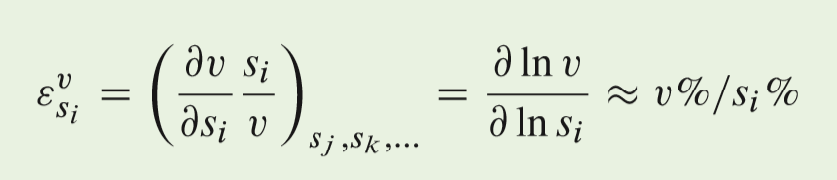
Small Example
Local Sensitivities (elasticities):

Slide 12
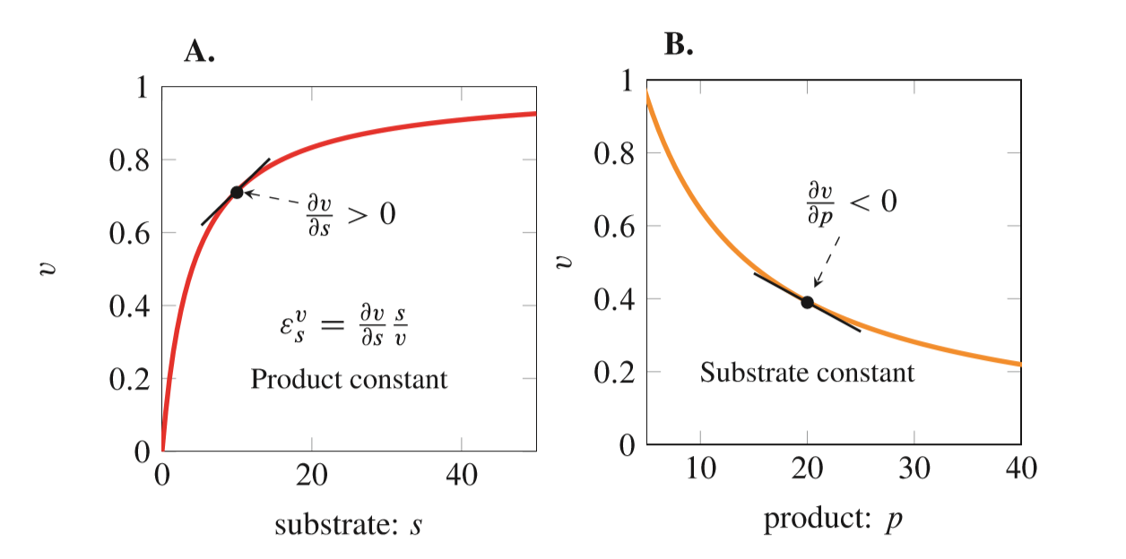
Elasticities: Local Properties
The slope of the enzyme rates laws at a given reactant
concentration determines how much the reaction rate changes.

Slide 13
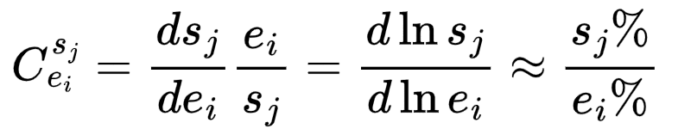
Small Example
Global Sensitivities (Control Coefficients):
They measure how sensitive a given variable is to a parameter

Slide 14
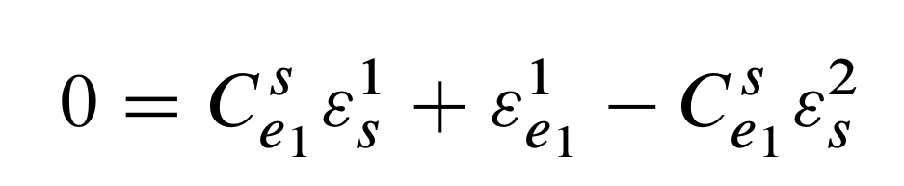
Small Example
Global Sensitivities (elasticities):

Slide 15
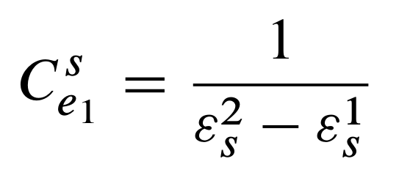
Small Example
Global Sensitivities (elasticities):

Slide 16
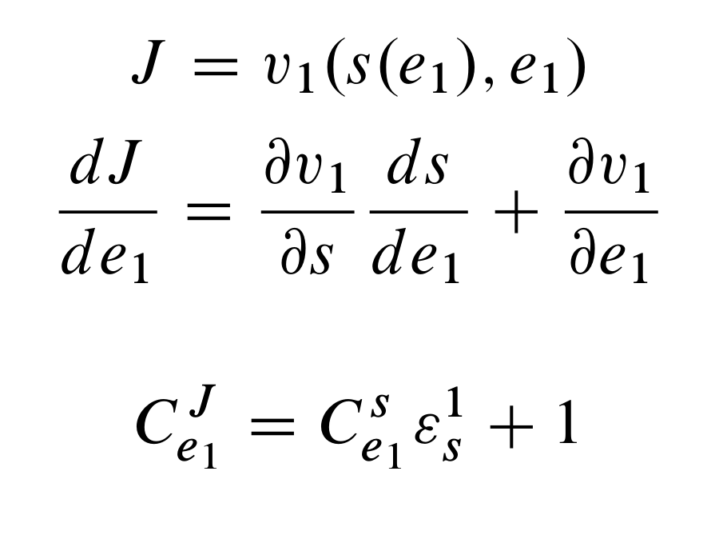
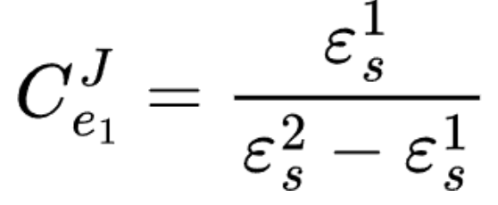
Small Example: We can also do fluxes

Slide 17
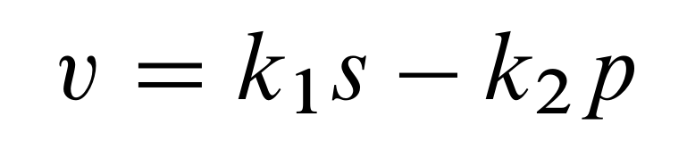
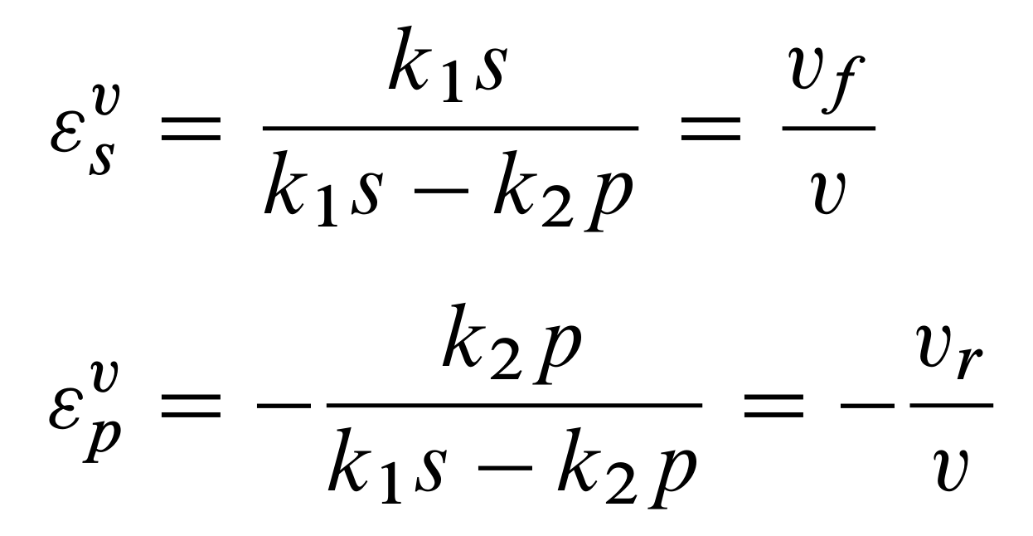
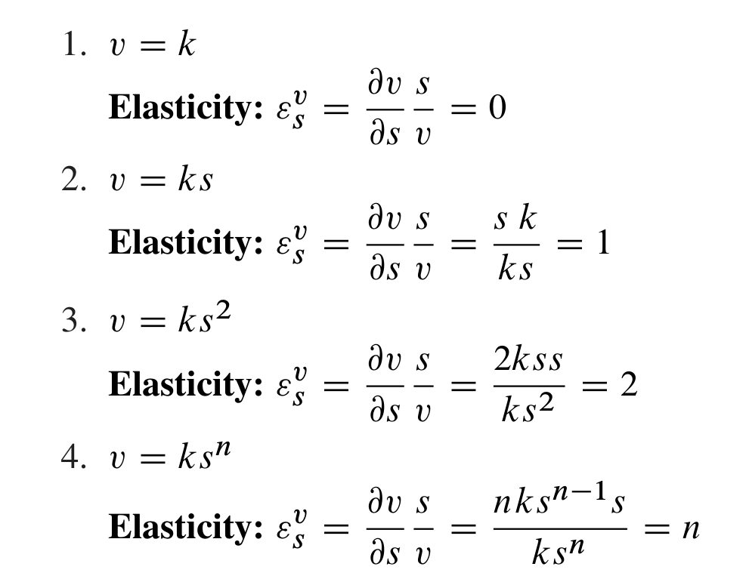
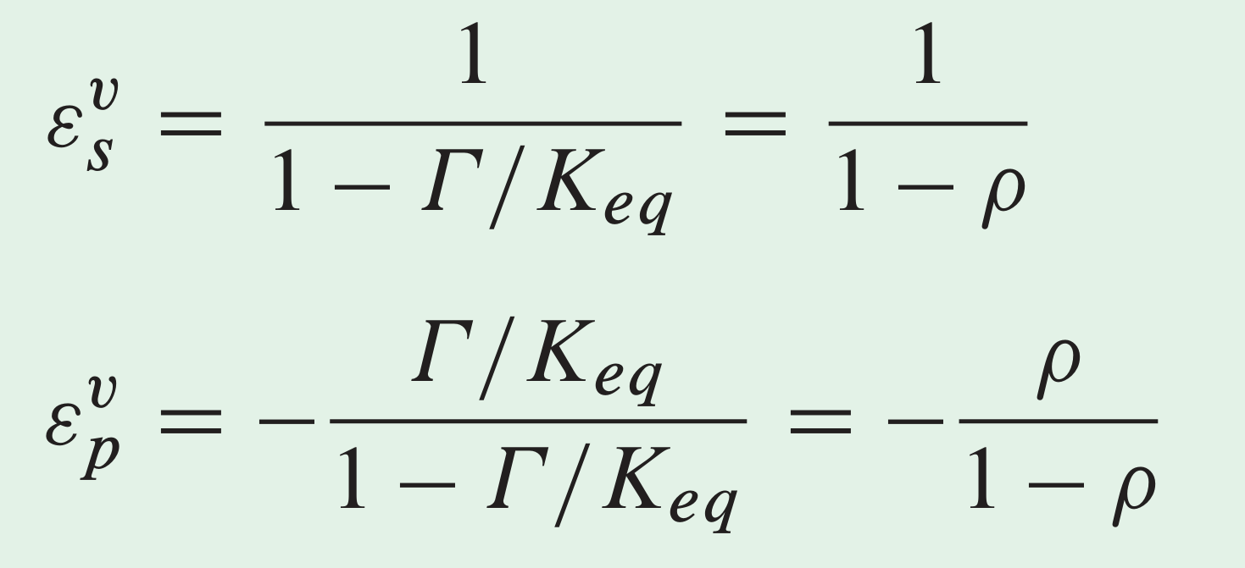

Elasticities: Examples
Mass-Action Kinetics (Reversible)
Mass-Action Kinetics (Irreversible)

Slide 18
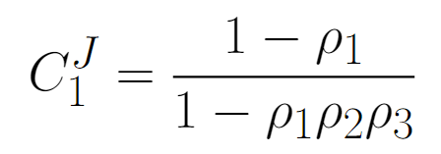
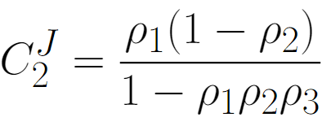
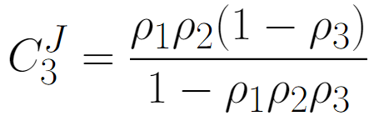
Relationship to the Disequilibrium Ratio
The same equations for a three-step pathway:
The free energy of a reaction is given by:
These equations tell us that the rate-limiting-ness of a given reaction is a function of all the individual free energies. You cannot tell how important a given reaction is from its free energy alone.

Slide 19
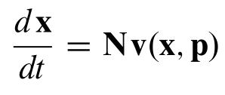
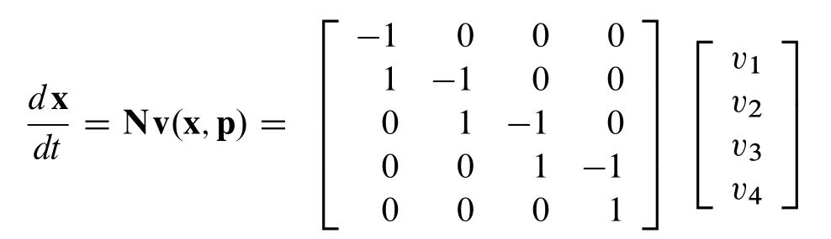
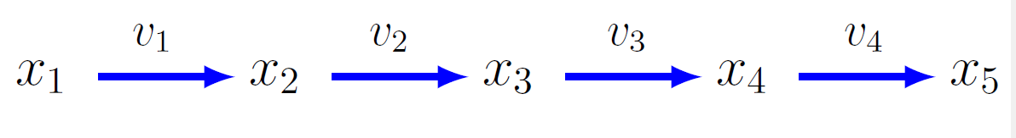
Generalized for any Biochemical Network
Stoichiometry,
Network Topology
Rate Vector

Slide 20
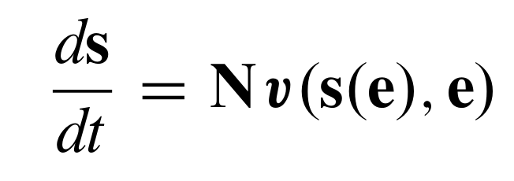
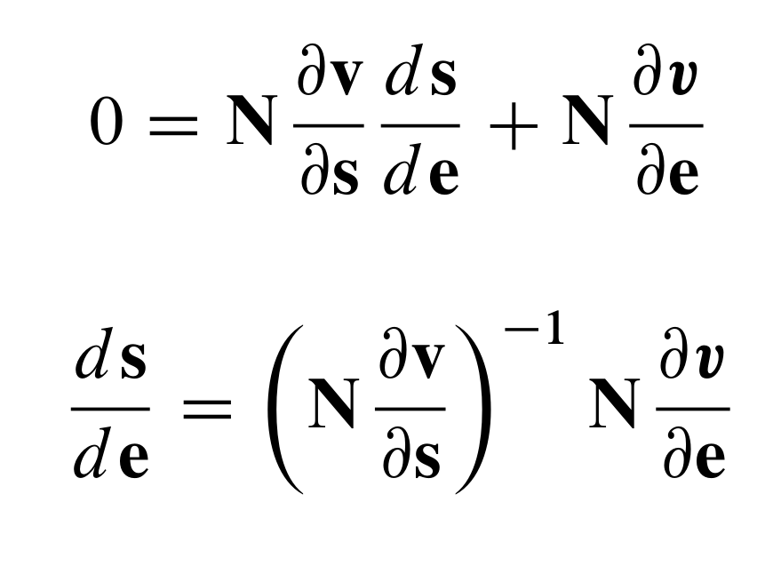
Gerenalized to Arbitrary Networks

Slide 21

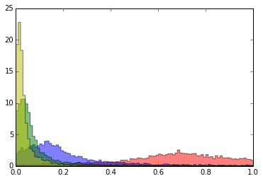
Effect of Negative Feedback
5000 simulations of a 4-step linear pathway. Randomizing
rate constants while keeping Keqs fixed.
Step 4
Frequency
Step 3
Step 1
Step 2
Flux Control Coefficient

Slide 22
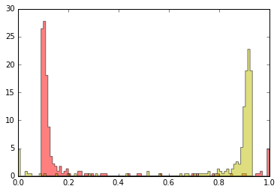
Effect of Negative Feedback
In the presence of negative feedback, a large proportion of the
flux control moves downstream
Step 1
Step 4
Frequency
Kacser H, Burns JA. The control of flux. Symp Soc Exp Biol. 1973;27:65-104. PMID: 4148886.
Sauro H.M, 2017. Control and regulation of pathways via negative feedback. Journal of the Royal Society Interface.
Flux Control Coefficient

Slide 23
Effect of Negative Feedback
In the presence of negative feedback, a large proportion of the
flux control moves downstream
This is why regulated steps such as phosphofructokinase in glycolysis are not rate-limiting.
Experimental measurements have repeatedly shown this to be the case.
Control Coefficient
Sauro H.M, 2017. Control and regulation of pathways via negative feedback. Journal of the Royal Society Interface.

Slide 24
Effect of Negative Feedback
In the presence of negative feedback, a large proportion of the
flux control moves downstream
Why does this happen?
Because the feedback stabilized S3
Control Coefficient
Sauro H.M, 2017. Control and regulation of pathways via negative feedback. Journal of the Royal Society Interface.

Slide 25
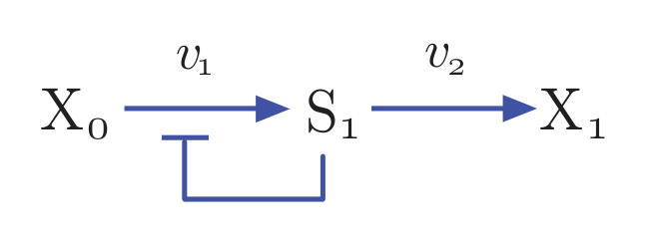
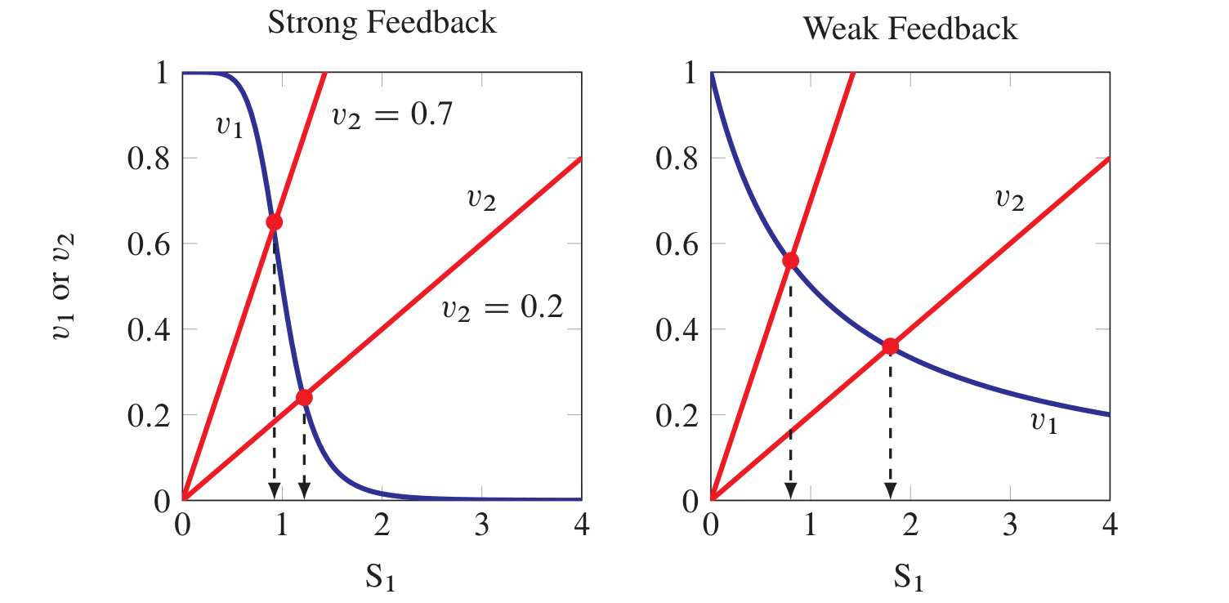
Stabilization of End Product
Sauro H.M, 2017. Control and regulation of pathways via negative feedback. Journal of the Royal Society Interface.

Slide 26
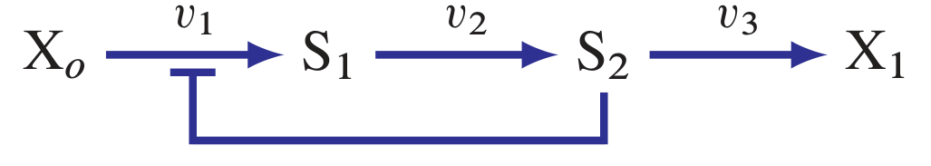


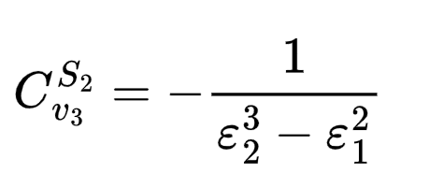
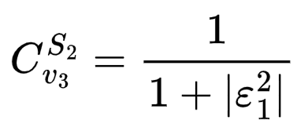
Stabilization of End Product
If v3 is a mass-action reaction then = 1
Typical value for the strength of the feedback ~ -4, therefore sensitivity = 0.2

Slide 27
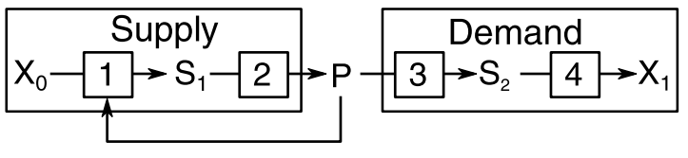
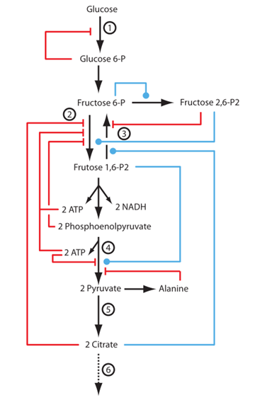
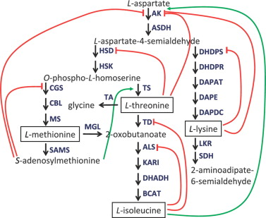
Modularity based on Feedback
Negative feedback insulates the supply block for changes in the demand block
Real example is amino
acid biosynthesis
but also Glycolysis
and Last part of EGF pathway
Sauro H.M, 2017. Control and regulation of pathways via negative feedback. Journal of the Royal Society Interface.
Christensen, Carl & Hofmeyr, Jan-Hendrik & Rohwer, Johann. (2015). Tracing regulatory routes in metabolism using generalised supply-demand analysis. BMC Systems Biology. 9. 10.1186/s12918-015-0236-1.

Slide 28
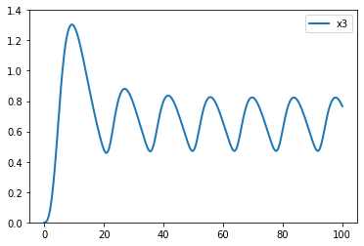
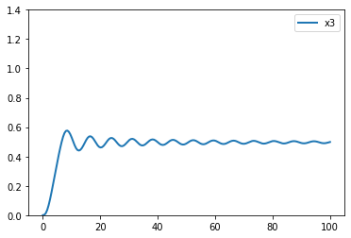
Faithfully transmitting a signal from process A to process B without loss of signal
A.
S
Low demand
Demand
// Reactions:
J0: $X0 => S1; VM1*(X0 - S1/Keq1)/(1 + X0 + S1 + S4^h)
J1: S1 => S2; (10*S1 - 2*S2)/(1 + S1 + S2)
J2: S2 => S3; (10*S2 - 2*S3)/(1 + S2 + S3)
J3: S3 => S4; (10*S3 - 2*S4)/(1 + S3 + S4)
J4: S4 => $X1; V4*S4/(KS4 + S4)
// Species initializations:
S1 = 0; S2 = 0; S3 = 0; S4 = 0; X0 = 10; X1 = 0
// Variable initializations:
VM1 = 10; Keq1 = 10; V4 = 2.5; KS4 = 0.5;
h = 10;
5x demand

Slide 29
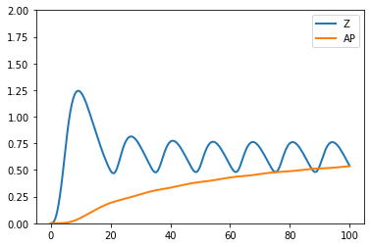
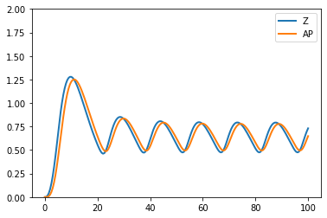
Faithfully transmitting a signal from process A to process B without loss of signal
Insulator
Phosphorylation Cycle
A.
A
Slow Cycle
S
AP
Fast Cycle
Shah R, Del Vecchio D. Signaling architectures that transmit unidirectional information despite retroactivity. Biophysical journal. 2017 Aug 8;113(3):728-42.

Slide 30
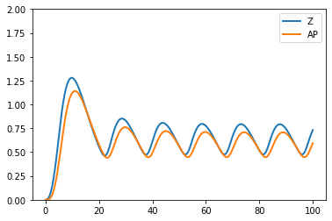
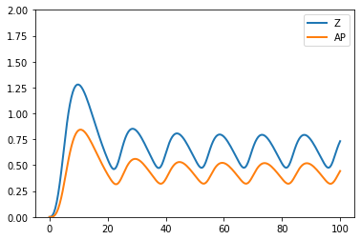
Faithfully transmitting a signal from process A to process B without loss of signal
Insulator
Phosphorylation Cycle
A.
A
Low demand
S
AP
5x demand
Demand
Shah R, Del Vecchio D. Signaling architectures that transmit unidirectional information despite retroactivity. Biophysical journal. 2017 Aug 8;113(3):728-42.

Slide 31
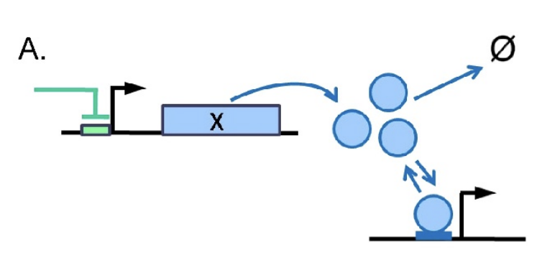
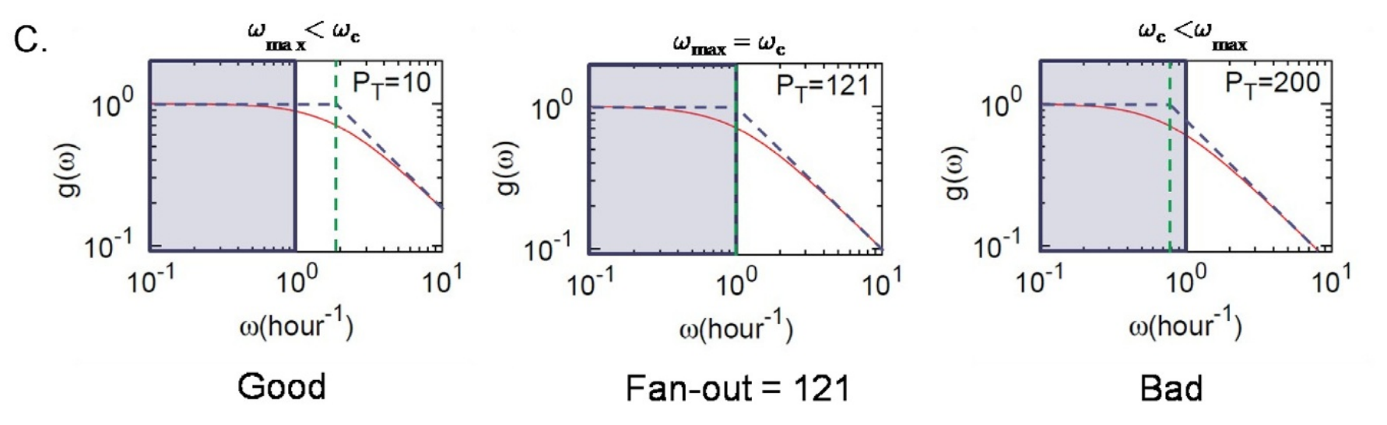

Gene Circuits: Fan-out
Without Feedback
It's possible to define the fan-out, which is the number of downstream elements that can be controlled without significant loss of signal.
Defined in terms of the bandwidth (green line) of the system. The bandwidth, and hence the fan-out, can be increased via negative feedback.
Kim, K.H., Sauro, H.M. Fan-out in gene regulatory networks. J Biol Eng 4, 16 (2010). https://doi.org/10.1186/1754-1611-4-16

Slide 33







Constraints on scaled coefficients:
=

Slide 34


Constraints on CJ:
=

Slide 35

Constraints:

